Slide 1
Ethics: the Key to
Media Futures and Citizens Rights
Aidan White
Director, EJN

Slide 2
Rules of the Game have Changed
The open information landscape is more polarized, more politicised and more dangerous.
Journalism is digital and democratized, but it faces new challenges to survive.
Technology is driving change, but we don’t fully understand it’s impact on our lives.

Slide 3
The Digital Challenge
A business model (Facebook, Google, etc.) that Ignores Publisher Responsibilities.
Audience that lacks interest in other points of view. Echo chambers and Confirmation Bias.
Online bias and targeted political propaganda that is beyond existing regulation.
How do we build values and ethics into the new communications culture?

Slide 4
The Open Information Crisis Internet: Pressures on Journalism from all Sides
State
Media
Corporate Power
Citizens’ Voice

Slide 5
Open Information Crisis
More Propaganda and Public Relations
A Flawed Culture of Communications: ”free” for all, anonymity, self-interest and fact-free – emotionally driven
Online portals that are unethical and lack transparency
Government failing to address the urgent crisis facing journalism and democracy

Slide 6
The Fake News Challenge
“The Deliberate Fabrication of Information with the Intention to Deceive.”
It’s not about bad journalism. It’s about selling malicious lies and distortion. It’s Driven by extremism and unscrupulous politics.

Slide 7
Journalism is not Free Expression
Journalism not unrestrained free speech, it is constrained expression. It has public purpose and works in a framework of values. It is Other regarding.
Free Expression gives voice to bias, and even offensive opinion including fake news. It is Self-regarding.

Slide 8
Ethical Journalism: The 5 Core Values
Accuracy, and fact-based communication
Independence
Impartiality
Humanity
Accountability and Transparency

Slide 9
The Political Challenge

Slide 10
Information Wars: A Global Crisis
Europe: Russia-Ukraine: Western Balkans
Middle East: Syria, Gulf states, Iraq, Palestine
East Asia: China, Japan, Korea
Africa: Burundi, Somalia, Egypt
South Asia: India, Pakistan

Slide 11
Hate in the News
Islamaphobia
Anti-Semitism
Genocide
Religion
Race relations
Migration
Gender equality
Homosexuality

Slide 12
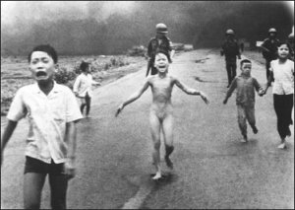
News or Obscenity?
Who Decides in the Digital Age?

Slide 13
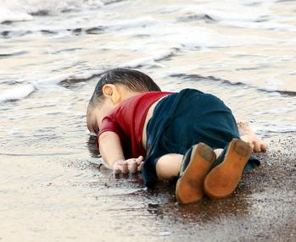
Why Ethical Choices Matter

Slide 14
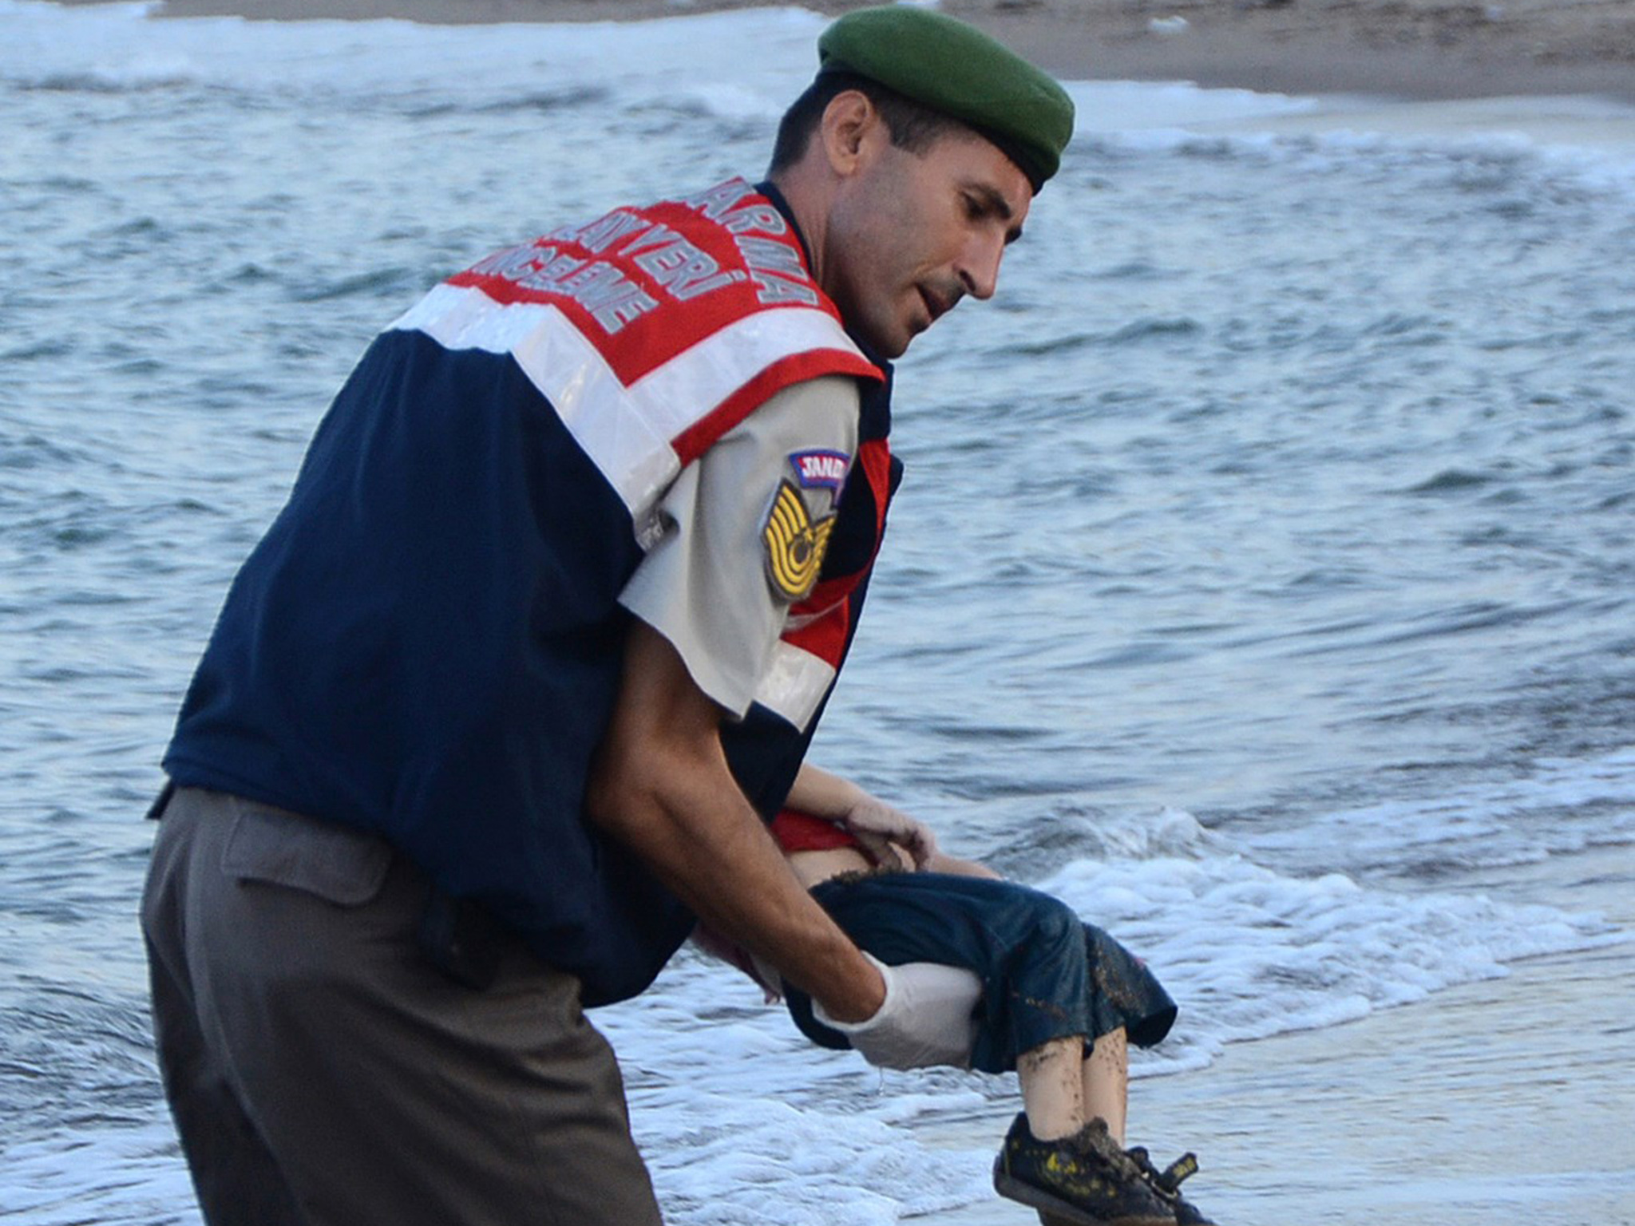

Slide 15
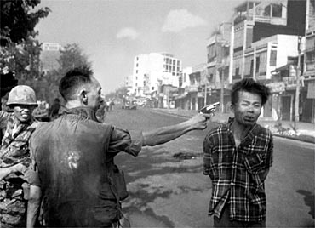
Ethical Choices: Inhumanity in the News

Slide 16
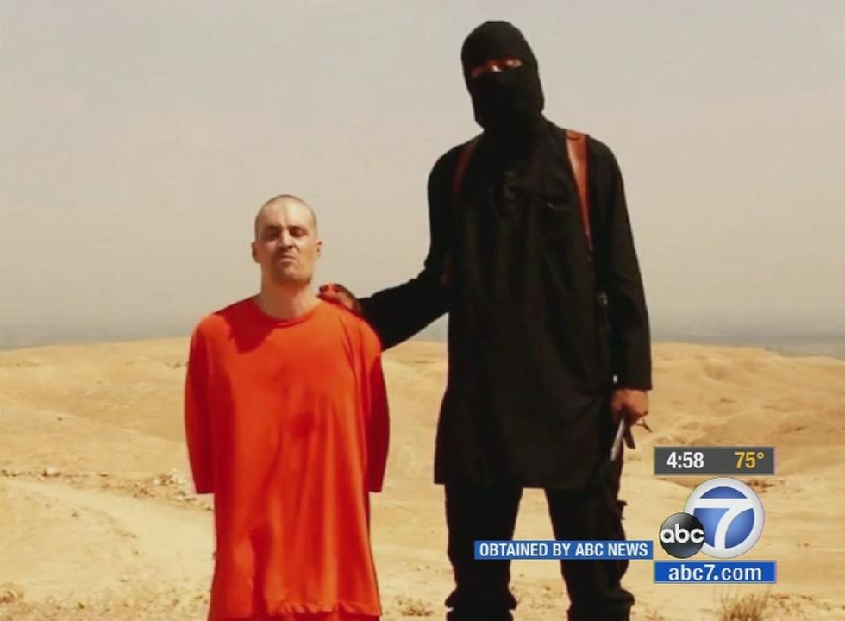
News or Propaganda?
The Slick and Seductive Power of the Net

Slide 17
What Can We Do?
Strengthen journalism and editorial independence.
Challenge fact-free, abusive and intolerant communications.
Promote responsible communications online through new media literacy movement
Build respect in public sphere for ethics, journalism and communication values

Slide 18
Preparing for the Future of Journalism
New Forms of Funding: A mix of public and private support
Creating Trusted Brands: Ethics and Transparency in Management
Newsroom Skills: Understanding and using AI and Technological Tools

Slide 19
Preparing for the Future of Journalism
Engaging with the audience: social networks as an editorial tool
Framing stories: rethinking language and context
Constructive and positive journalism.
Public Alliances to Defend Pluralism

Slide 20
What Must We Do Now?
Challenge fact-free, abusive and intolerant communications.
Demand responsible communications from corporate and political centres of power.
Strengthen journalism and ethical values.
Build a new information literacy movement to support core ethics (facts, transparency and humanity) in the public sphere

Slide 21
Five Proposals:
Use Ethical Journalism as an inspiration for civil public communications.
Support Self-regulation and Avoid Legal Controls.
Self Regulation works at three levels:
a) The Individual
b) The Enterprise
c) Across the Industry

Slide 22
What More Can We Do? Support Ethical Journalism Communicate Responsibly

