Slide 1
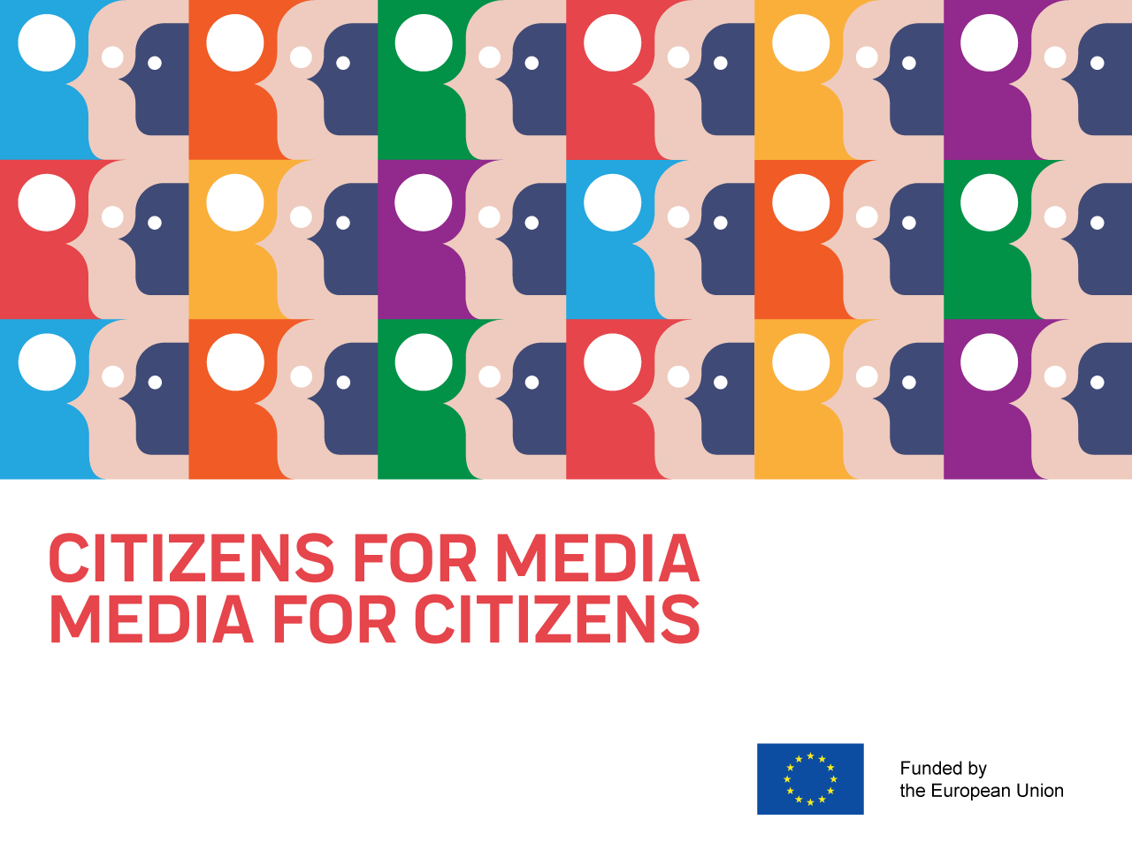
Novi Sad
23.11.2018
#MediaforCitizens #MediaLiteracy #MCCM

Slide 2

MAPPING AND UNDERSTANDING mil DEVELOPMENTS IN THE REGION
Speaker:
Brankica Petković
Regional research coordinator,
Peace Institute, Ljubljana
#MediaforCitizens #MediaLiteracy #MCCM

Slide 3
General context and influences
Media and information literacy more and more suggested as an answer to all problems and failures of media policies on European and national levels.
The previous concept of media literacy extended to include information literacy, sometimes also reference to digital literacy, internet literacy, data literacy etc.
Focus on citizens‘ or consumers‘ empowerment? On safety or creativity? On media and information as a danger or a chance to practice critical thinking and democracy?
#MediaforCitizens #MediaLiteracy #MCCM

Slide 4
General context and influences
Influential international actors, also in our region (agenda and policy setting, transfer of knowledge, funding…): UNESCO, EU, COE, UNICEF, OSCE…
EU accession: EU Directive on AMVS (2010, 2018) and reference to ML.EC Recommendations on media literacy, 2009.
EU, UNICEF, Save the Children: continuous support to actions on safe internet for children.
#MediaforCitizens #MediaLiteracy #MCCM

Slide 5
Our research
Conducted between April and October 2018 in Albania, Bosnia and Herzegovina, Macedonia, Montenegro and Serbia.
Included developing of joint MIL definition, overviewing relevant literature on MIL in each country, mapping of main MIL actors in each country (classified in 11 types/sectors), mapping of main MIL initiatives in each country and on regional level (considering 5 categories of media literacy skills which the initiatives promote), selection of topics for country-specific thematic research to meet the research needs in each country, and implementation of the thematic research.
Not the first MIL research of the SEENPM network on regional level. Related also to media integrity research.
#MediaforCitizens #MediaLiteracy #MCCM

Slide 6
Our research
The country research reports include introduction with brief overview of the MIL situation and developments (based on mapping main actors and initiatives), followed by chapters with findings of thematic research, conclusions and recommendations for policy changes.
The regional overview will follow with comparative analysis of five countries put in the wider context of MIL policies on European level.
Publications with country reports and regional overview in English and national languages will be published and distributed in the coming month or two.
#MediaforCitizens #MediaLiteracy #MCCM

Slide 7
Our MIL definition as applied in the project
Based on the literature and on policy documents of UNESCO, EU, CoE etc.
Extended to include media and information literacy.
Seen in the frame of human rights protection, secondary in the frame of consumer protection.
Seen as related to competencies of citizens concerning their interaction with all forms of media, media content and information offline and online on traditional and digital media and communication platforms and technologies.
#MediaforCitizens #MediaLiteracy #MCCM

Slide 8
Our MIL definition as applied in the project
MIL refers to cognitive, technical and social skills and capacities of citizens
to access, critically evaluate, use and contribute information and media content through traditional and digital information and media platforms and technologies with understanding how these platforms and technologies function, how to manage own rights and respect rights of others when using them, how to identify and avoid harmful content and services, with purpose to make effective use of information and media content and platforms in order to meet their individual and community needs and interests and exercise their active and responsible participation in traditional and online public sphere and in democratic processes.
#MediaforCitizens #MediaLiteracy #MCCM

Slide 9
Highlights of the research findings: regional comparative perspective
58 MIL initiatives reviewed (ALB: 9, BIH: 14, MK: 12, MNG: 7; SRB: 11, REGIONAL: 5)
Overall dominant sector: Civil society, followed by public authorities/bodies and formal education system, academic and research community, online platforms devoted to various MIL components…
Less: media industry, AV and IT industries, libraries. National libraries more engaged in Montenegro and Albania.
Overall dominant target group: students, mostly in secondary schools.
Dominant MIL skills promoted: Media and information use; Critical understanding; Participation and interaction.
Less: Creation/production and contribution of media content and information.
#MediaforCitizens #MediaLiteracy #MCCM

Slide 10
Public policy level, MIL strategy development, strategic coordination of stakeholders
CURRENT/ONGOING:
BiH: strategy development under Ministry of Civil Affairs (influence of regional UNESCO/EU funded project „Building Trust in Media“ and work of Institute for Social Research, FPS)
Serbia: national consultations around MIL strategic steps ad policy development, under Ministry of Culture and Information (supported through media programs of EUD)
Montenegro: initiative by the National Library, developed baseline for MIL strategy; plus new engagement by the regulatory agency for electronic media
Macedonia: ongoing initiative by the regulatory agency for AVMS - „Media Literacy Network“ – coordination and policy consultations with 38 stakeholders/ members (ref. Law on AVMS obliges the regulator to promote media literacy).
Albania: adopted Digital Agenda Strategy, focus on ICT; AVMS regulator: limited engagement
#MediaforCitizens #MediaLiteracy #MCCM

Slide 11
Public authorities/bodies
NEW INITIATIVES, GOOD PRACTICES:
BiH: 2018: „Strengthening media literacy of children in Republika Srpska“ – 3 year project, set of awareness raising activities by Ministry of Communication and Traffic of Republika Srpska in cooperation with Ministry of Education and Culture, Pedagogical Institute and RTV Republika Srpska, within state budget, no separate funds dedicated, based on enthusiasm
Montenegro: 2018: Agency for Electronic Media (regulatory authority) - research on media use among children and parents + awareness campaign – 3 year project – in cooperation with UNICEF
CONTINUOUS WORK:
Macedonia: Agency for AVMS: strategic documents, surveys, education materials for elementary schools, awareness campaigns targeting general public etc. – based on the 2013 legal obligation to promote MIL
#MediaforCitizens #MediaLiteracy #MCCM

Slide 12
MIL in formal education
Albania: no specific subject in elementary or secondary schools but some aspects of MIL addressed through other subjects, focus more on ICT skills (previous/2010 AMI initiative and strategic work on curricula and texbooks and initiative failed)
BiH: „underrepresented“, no specific subject, some aspects of MIL addressed through other subjects
Macedonia: „in chaotic manner“, in different subjects, focus on „media culture“ (previous/2009-2011 MIM initative and strategic work on training of 1,000 teachers failed)
Montenegro: optional subject Media Literacy in gymnasiums since 2008, decline of interest among students;
2018 – new subject for university students of media studies and journalism at FPS in Podgorica.
Serbia: 2018: news optional subject/program „Language, media and culture“ in gymnasiums
#MediaforCitizens #MediaLiteracy #MCCM

Slide 13
Civil society organisations for MIL
Pioneers, more than 10 years of engagement in promotion of media literacy.
Project-based (short term projects), dependent on donor support.
Main donors: EU, USAID, NED…
Wide range of activities: media watch, research, advocacy, informal education/training of teachers and students, publishing, awareness raising
Strong in decentralized actions: not only in capital city (Macedonia, Serbia, BiH).
#MediaforCitizens #MediaLiteracy #MCCM

Slide 14
Civil society organisations for MIL
Common trend across the region:
CSO engagement on web sites for fact-checking and countering disinformation (Faktoje, Raskrinkavanje, Vistinomer, Istinomer…)
+ audiovisual media campaigns on countering propaganda and disinformation (MIM: Dr. Dragan Expert Manupulator; Share Foundation: In the Network/ U mreži)
+ regular regional events on impact of ICT on society and democracy (Point conference + Digital Born Media Carnival)
#MediaforCitizens #MediaLiteracy #MCCM

Slide 15
Media, AV and ICT industry
Rare engagement of media industry in promotion of MIL.
Good practices:
Macedonia: several continuing joint actions of media industry and School of Journalism (Media Day since 2014, Media Camp since 2014, Medium since 2011)
Serbia: Media Coalition (2013-2014) and Media Association ASMEDI (2016) engagement in raising understanding of media by students and general public
BIH: Press Council, a self-regulatory body of print and online media through processing complaints, constantly explaining the media to citizens and citizens to media, raising critical undestanding
#MediaforCitizens #MediaLiteracy #MCCM

Slide 16
Media, AV and ICT industry
Little or nothing done by public service media, including Macedonia despite explicit legal obligations;
in Albania: weekly morning talk on MIL at RTSH (PSB)
AV/Film sector: Makedox - Traveling cinema to rural area in Macedonia (2010-2018), handbook on film production
ICT sector: across the region – ICT companies‘ workshops mostly for students on coding etc. BIH: Mostar – cooperation between telecom and university (2018)
#MediaforCitizens #MediaLiteracy #MCCM

Slide 17
Conclusions
Despite some new positive developments toward strategic approach to MIL by public authorities in several countries of the region, these are sporadic steps with uncertain final outcome. Cooperation between governmental bodies responsible for media and educational policies urgently needed.
Media regulators can become substantial actors if such role is given and taken seriously.
Benefits of collaborative efforts: networking, coalition-building and coordination of all MIL-related stakeholders on national level.
Particularly useful joint strategic work/collaborative actions of public bodies and civil society or public bodies, civil society and media.
#MediaforCitizens #MediaLiteracy #MCCM

Slide 18
Conclusions
Engagement of media and journalists is lacking; with narrow focus on own survival strategies they lose momentum to connect with citizens and invest in their empowerment.
Public service media have to become obliged and central actor within media community in promotion of MIL through own programming and operations, in empowerment of citizens, cooperation with schools etc.
MIL education for journalists/media professionals needed.
#MediaforCitizens #MediaLiteracy #MCCM

Slide 19
Conclusions
Systems of formal education complex and slow in reforms, but can bring massive empowerment if MIL is integrated as soon as possible. Strong emphasize and investment in formal and informal education of teachers on MIL needed; quality standards for MIL training of teachers important.
Digital media, ICT and internet – can be used more for MIL promotion and citizens empowerment. Small and big creative ideas should be encouraged and supported. Also through our project (sub-granting scheme).
#MediaforCitizens #MediaLiteracy #MCCM

