Slide 1
EMFA PROPOSAL AND PROBLEMS OF MEDIA CAPTURE IN SOME EU MEMBER STATES
Brankica Petković, Mirovni Institut, Slovenia and
Beata Klimkiewicz, Jagiellonian University, Poland

Slide 2
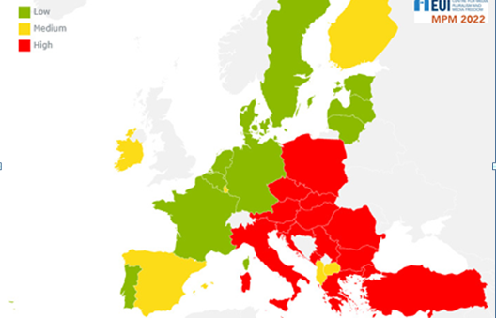
Independence of PSM governance and funding MPM,2022 -”relatively clear division between Northern and Western Europe, on the one hand, and Central, Eastern and Southern Europe, on the other...“ High risk in half of the countries (16): Austria, Bulgaria, Croatia, Cyprus, Greece, Hungary, Italy, Malta, Montenegro, Poland, Romania, Serbia, Slovakia, Slovenia, The Czech Republic, and Turkey.

Slide 3
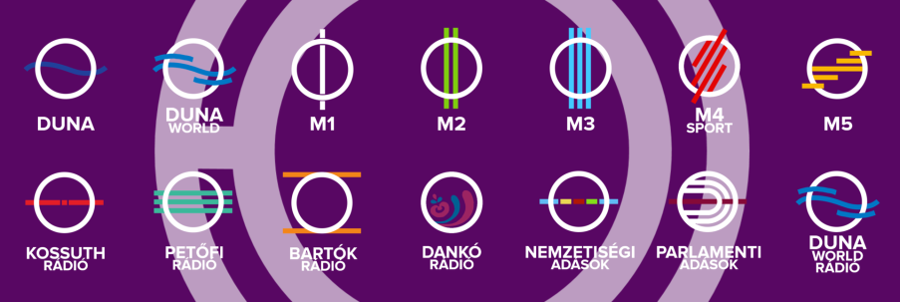
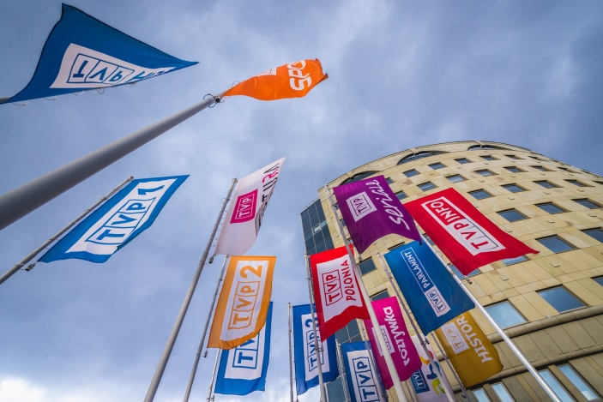
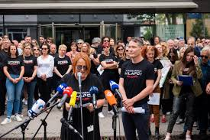
INDEPENDENT FUNCTIONING OF PUBLIC SERVICE MEDIA, EMFA, ARTICLE 5.
PSM INDEPENDENCE SAFEGUARDS IN EMFA – (IN)SUFFICIENT TO COUNTER PSM CAPTURE IN SOME EU MS?
•Vera Jourova on EMFA: We need to establish clear principles:/.../ no public media should be turned into propaganda channel.
•obligation of impartiality and plurality of information and opinion of PSM vs. PSM as propaganda tool of governing parties in some EU MS, impact on elections
•obligation of transparent, open and non-discriminatory appointment of PSM head and governing board, based on objective criteria, set by national law vs. appointment procedures facilitate political capture of PSM management and governance
•EMFA lacks provisions on pluralistic and balanced composition of governing board (cf. EBU position paper, March 2022)

Slide 4
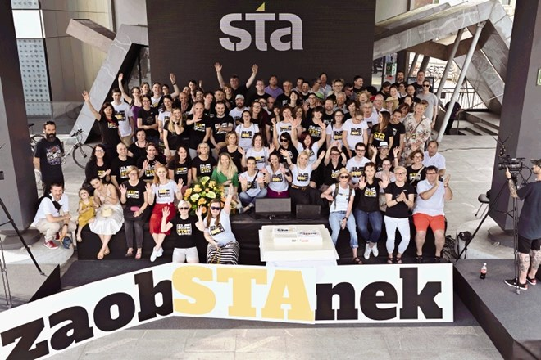
INDEPENDENT FUNCTIONING OF PUBLIC SERVICE MEDIA, EMFA, ARTICLE 5.
PSM INDEPENDENCE SAFEGUARDS IN EMFA – (IN)SUFFICIENT TO COUNTER PSM CAPTURE IN SOME EU MS?
•duration of term of office, grounds for dismissals vs. difficulties to dismiss politically appointed managament and governing board, serving interests of particular political group
•EMFA obligation to ensure adequate and stable financial resources vs. gov depriving independent PSM from funding (STA, Slovenia, 2021) or hefty, non-transparent state funding of gov propaganda PSM (Hungary, Poland)
•EMFA lacks provision on transparency of financial resources provided by the Member State to PSM

Slide 5
INDEPENDENT FUNCTIONING OF PUBLIC SERVICE MEDIA, EMFA, ARTICLE 5.
PSM INDEPENDENCE SAFEGUARDS IN EMFA – ENFORCEMENT?
•EMFA obligation to designate independent authorities or bodies to monitor compliance with EMFA PSM safeguards vs. politically captured PSM Regulatory Authorities in HU and POL (involved also in appointment of PSM governing board or management); SLO: politically captured PSM governing body as regulator on editorial standards, while NRA has no powers to monitor PSM governance or funding...
How and by whom the EC (and European Board) intervention can be initiated in case of non-compliance?
Role of EC and European Board in review of new national laws on PSM?

Slide 6
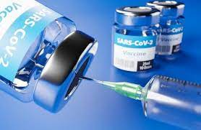
ALLOCATION OF ECONOMIC RESOURCES, EMFA SECTION 6 (ARTICLES 23 AND 24)
LEGAL RECOGNITION IS IMPORTANT - transparent and fair allocation of economic resources remains problematic in a number of EU member states
in some countries, unfair allocation of state advertising is used to control the media and influence sympathetic coverage or impair position of those media that offer more critical reporting

Slide 7
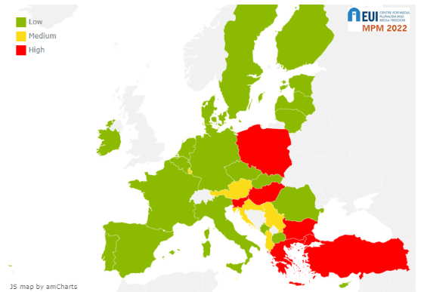
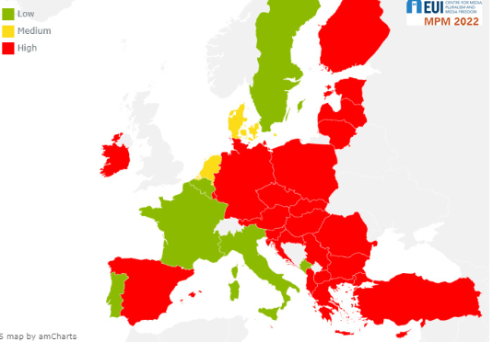
MPM: Regulation of state resources and suport for the media 2022
MPM: Distribution and transparency of state advertising 2022

Slide 8
WEAKNESSES: ARTICLE 24 (2)
the list of public institutions obliged to share information on advertising is limited
excluded: entities at the national or regional level or local governments of territorial entities with less than 1 million inhabitants
question: how reliable, meaningful, comprehensive and understandable are the data shared with the public

Slide 9
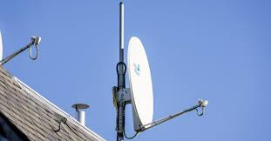
REGULATORY INDEPENDENCE: ARTICLE 9
Article 9: independence recognised at a very general level
what to do with national representatives if they do not respect independence in practice?
MPM: several EU Member States with medium risk concerning independence and effectiveness of MRA
e.g. unecessary postponing of licence granting procedurę (for 18 months) in the TVN 24 case (Poland)

Slide 10
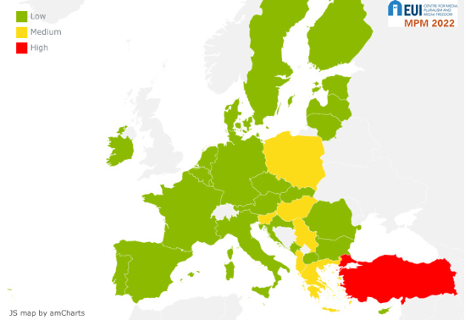
MPM: Independence and effectiveness of media regulatory agencies (MRA) 2022

